Slide 1
Performing Basic Linux Tasks
Identify the Linux Design Philosophy
Enter Shell Commands
Get Help with Linux

Slide 2
Open Source Software (Slide 1 of 2)
Computer code that any user is permitted to view, copy, and modify for any reason, as well as distribute to anyone.
Users are granted rights when author releases source code under an OSS license.
Opposite of proprietary software.
Released under a license that restricts rights.
Provides several advantages.
Encourages ongoing improvement of software.
Encourages collaboration and community-driven development.
Developers can customize/enhance others' code.
No legal issues.
The Linux kernel is OSS.

Slide 3
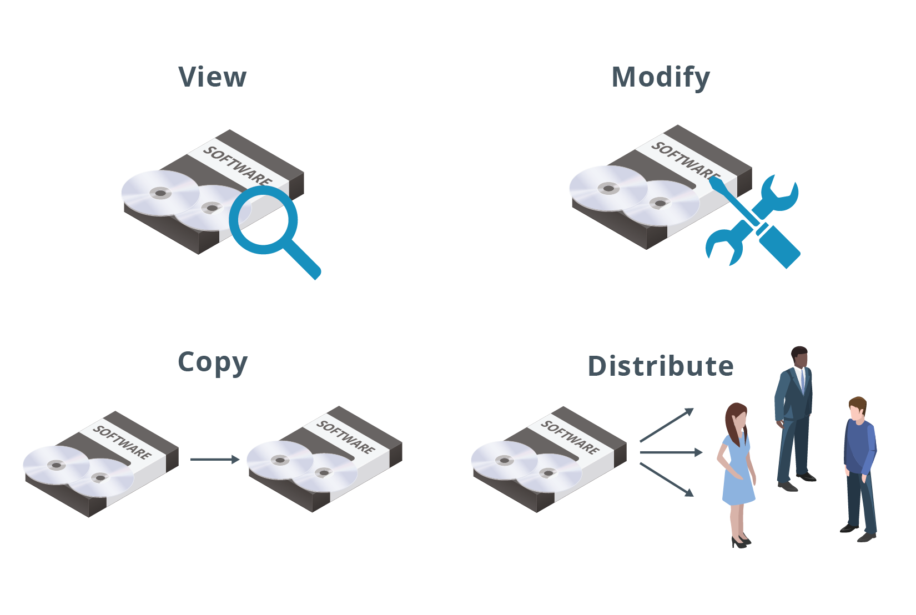
Open Source Software (Slide 2 of 2)

Slide 4
Free Software vs. Open Source Software (Slide 1 of 2)
Free software often conflated with OSS.
Very similar with a lot of overlap.
Some draw a distinction.
According to Richard Stallman:
"Open source is a development methodology; free software is a social movement."
OSS focuses on collaborative development.
Free software focuses on user rights.
"Free" as in freedom, not a lack of cost.
Free and open source software (FOSS):
Used as an alternative term.
Embodies values of both movements.

Slide 5
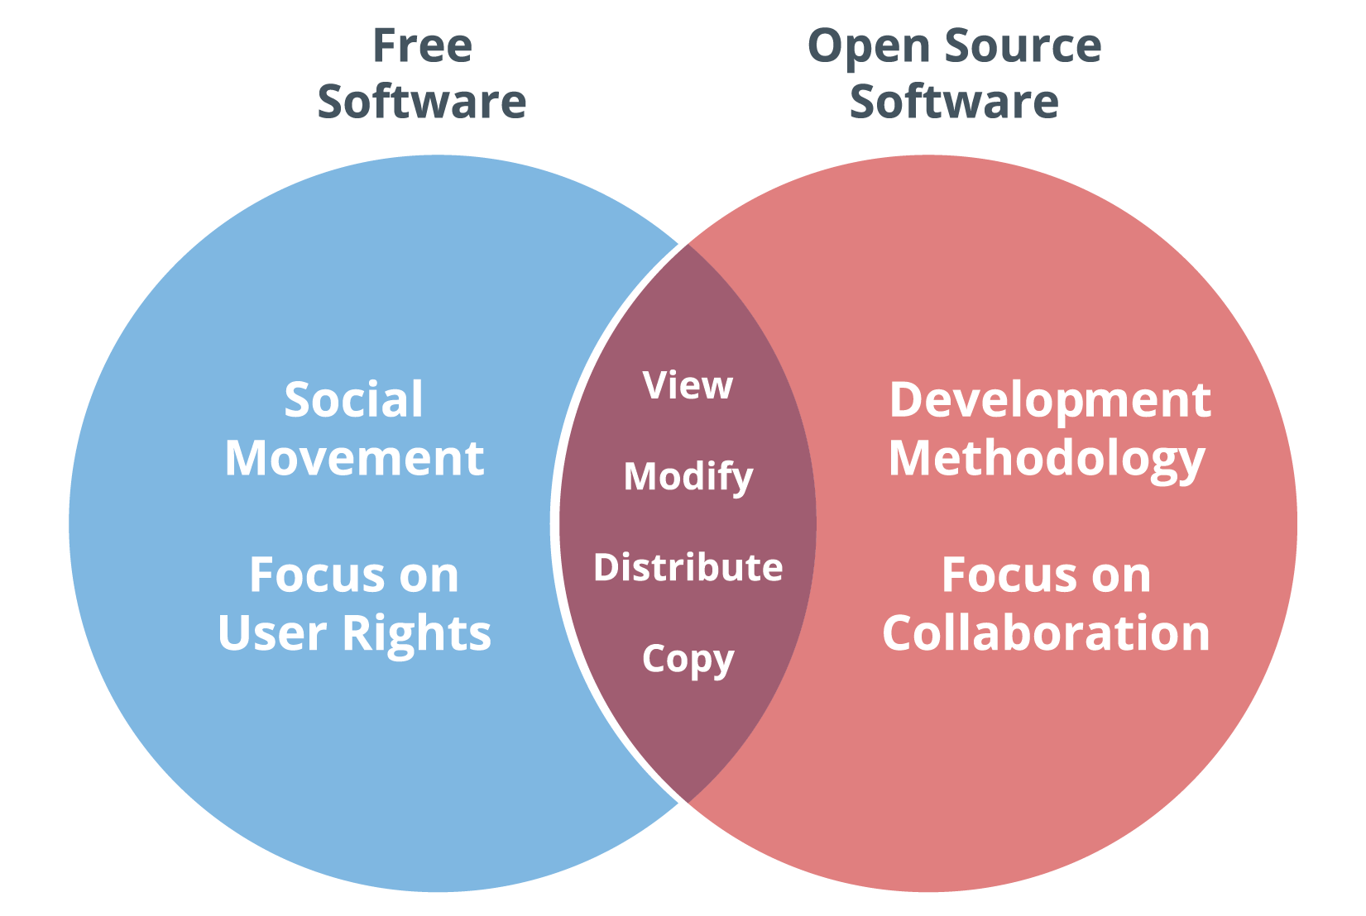
Free Software vs. Open Source Software (Slide 2 of 2)

Slide 6
The GNU Project
A free software project led by Richard Stallman.
Announced in 1983.
The first project of its kind.
Launched the free software movement.
Goal is to create an OS of only free software.
By the early 1990s, the Project had created several programs.
Most written by Stallman, like GCC and Emacs.
Other programmers created more later.
"GNU's Not Unix" is based on the design of Unix.
Doesn't include any Unix code.
Unix is proprietary.

Slide 7
The Unix Philosophy
A set of best practices and approaches to software development.
Emphasizes simplicity and modularity.
Created by lead Unix developers.
Key high-level points:
Do one thing and do it well.
Worse is better.
Support interactivity.
Handle I/O streams.
GNU software conforms to Unix philosophy.

Slide 8
The Linux Operating System Family (Slide 1 of 2)
A family of operating systems based on the Linux kernel.
Kernel is central core of OS that manages all other components.
Kernel developed by Linus Torvalds in 1991.
FOSS, GNU, and Unix play an important role in Linux's development.
Linux kernel released under GPLv2.
Most distributions add GNU software on top of kernel.
First complete OS family to qualify as FOSS.
Follows Unix principles of simplicity and modularity.

Slide 9
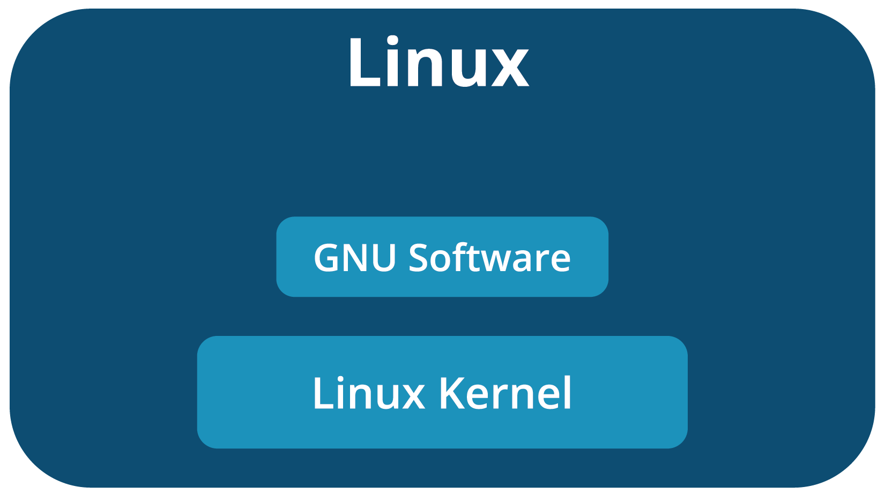
The Linux Operating System Family (Slide 2 of 2)

Slide 10
Advantages of Using Linux
FOSS nature promotes transparency.
Design emphasizes simplicity and modularity.
Highly customizable.
Highly reliable and stable.
Strong integration with common programming languages.
Emphasis on security and privacy.
Most distributions are free of monetary cost.
Has a passionate community that offers support.

Slide 11
Disadvantages of Using Linux
Sharper learning curve.
Desktop software is not as well-supported.
No official version; might confuse new users.
No official support for the most part.

Slide 12
Linux Distributions
Distinct members of the Linux OS family.
No official "Linux" OS.
All distros based on Linux kernel.
Different distros have different additional software and kernel version.
Kernel + additional software = fully functional OS.
Also differences in community, release rate, etc.
Choosing a distro is a matter of:
Identifying your business needs.
Familiarity with provided tools.
There are hundreds of distros.

Slide 13
List of Linux Distributions (Slide 1 of 2)
Distro | Notes
Slackware | Oldest distro still maintained. Most Unix-like, for advanced users.
Debian | Earlier distro composed entirely of free software. Basis for many derivative distros.
Ubuntu | One of the most popular distros for general use. Based on Debian.
Kali Linux | Debian-based distro. Used in penetration testing/other cybersecurity tasks.
RHEL | Comes with paid customer support. Common for servers in corporate environments.

Slide 14
List of Linux Distributions (Slide 2 of 2)
Distro | Notes
CentOS | No-cost version of RHEL. Same functionality, no support provided.
Fedora | Upstream source of RHEL. Multiple editions targeting different computing roles.
openSUSE | Sponsored by SUSE Linux GmbH. Incorporates FOSS tools.
SLES | Shares code base with openSUSE. More stable, comes with paid customer support.
Arch Linux | For experienced users; emphasizes simplicity. ArchWiki provides comprehensive documentation.

Slide 15
Uses for Linux
Role | Description
Servers | Provide services to multiple users over a network. Linux dominates web, cloud, and other server markets.
Workstations | Powerful desktops geared toward technical use. Slightly better Linux adoption than PCs.
Mainframes and supercomputers | Mainframes excel at processing concurrent transactions. Supercomputers excel at performing complex calculations quickly. Linux dominates both markets.
Mobile devices | Includes smartphones, tablets, etc. Android has over 80% of mobile device market.
PCs | Includes desktops and laptops. Only around 2% run Linux.
Embedded systems | Have specific functions in a larger system. Majority of market runs Linux.

Slide 16
Discussing the Linux Design Philosophy

Slide 17
Activity: Identifying the Linux Design Philosophy
You are a sysadmin at Develetech Industries.
A manufacturer of home electronics.
The CTO is considering switching company servers to Linux.
He wants to start a discussion about Linux.
What are its fundamental concepts?
What are its advantages and disadvantages?

Slide 18
The CLI
A text-based interface between the user and the OS that accepts input in the form of commands.
Presents prompt to user.
User enters command to interact with system.
Important tool in any admin's arsenal.
Developers and admins use CLI, end users tend to use GUI.
Comfort at CLI is essential, and an assumed skill.
A GUI is not required, and may not even be installed.
You can perform all administration at the CLI.

Slide 19
CLI Advantages and Challenges
Advantages:
Faster for system to process.
Faster for admins to enter info.
Commands can be stored as scripts to run a series of tasks.
Scripts can be scheduled to run on a regular basis.
Additional options available that may not be in GUI.
Challenges:
More difficult to learn than GUI.
Commands have many options and are not always consistent.
Often mistakenly thought of as legacy.
Many command-line environments in different OS platforms.

Slide 20
Shells (Slide 1 of 2)
A system component that permits users to pass commands and information to the kernel.
Interpreter between human and kernel languages.
Users issue commands in shell to tell OS what to do.
OS responds with results.
Can be either CLI or GUI.
CLI shells:
Bourne shell
Bash
C shell
KornShell

Slide 21
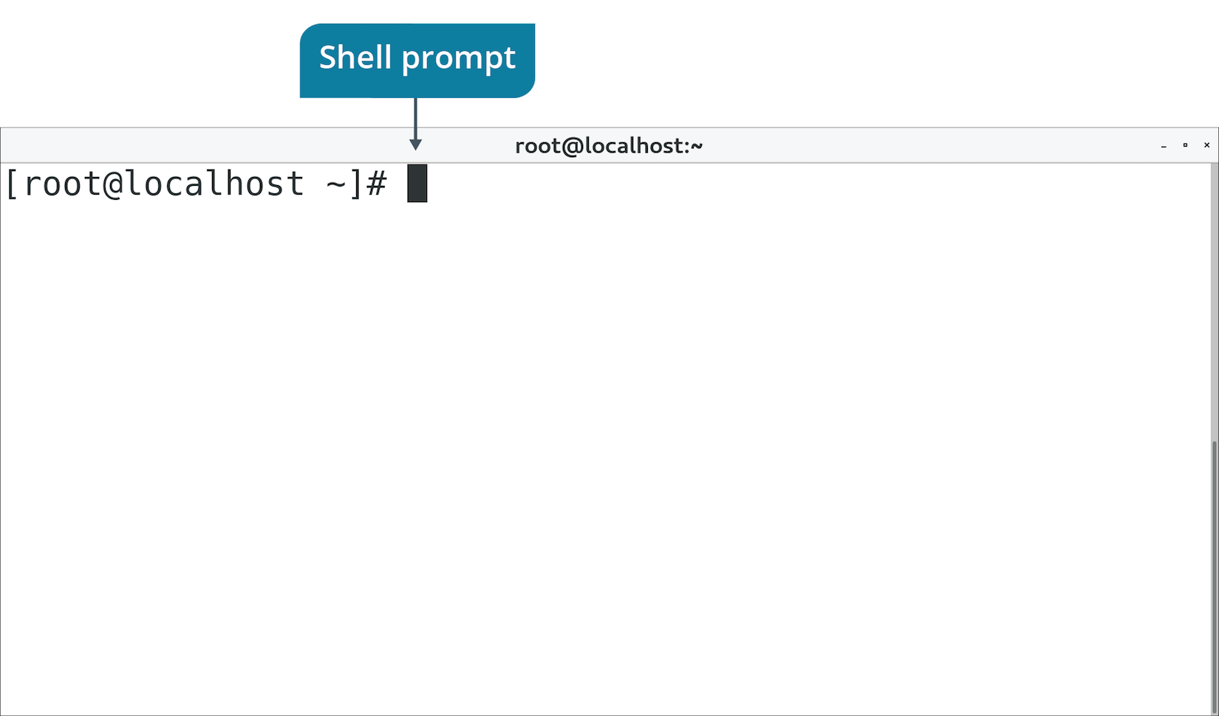
Shells (Slide 2 of 2)

Slide 22
Bash Syntax (Slide 1 of 2)
Basic syntax: command [-options] [arguments]
Syntax Format | Command | Description
Command only | ls | Lists directory contents with default output.
Command with options | ls –la | Lists directory contents in long format/shows hidden files.
Command with argument | ls /var/log | Lists directory contents of /var/log with default output.
Command with options and argument | ls –la /var/log | Lists directory contents of /var/log in long format/shows hidden files.

Slide 23
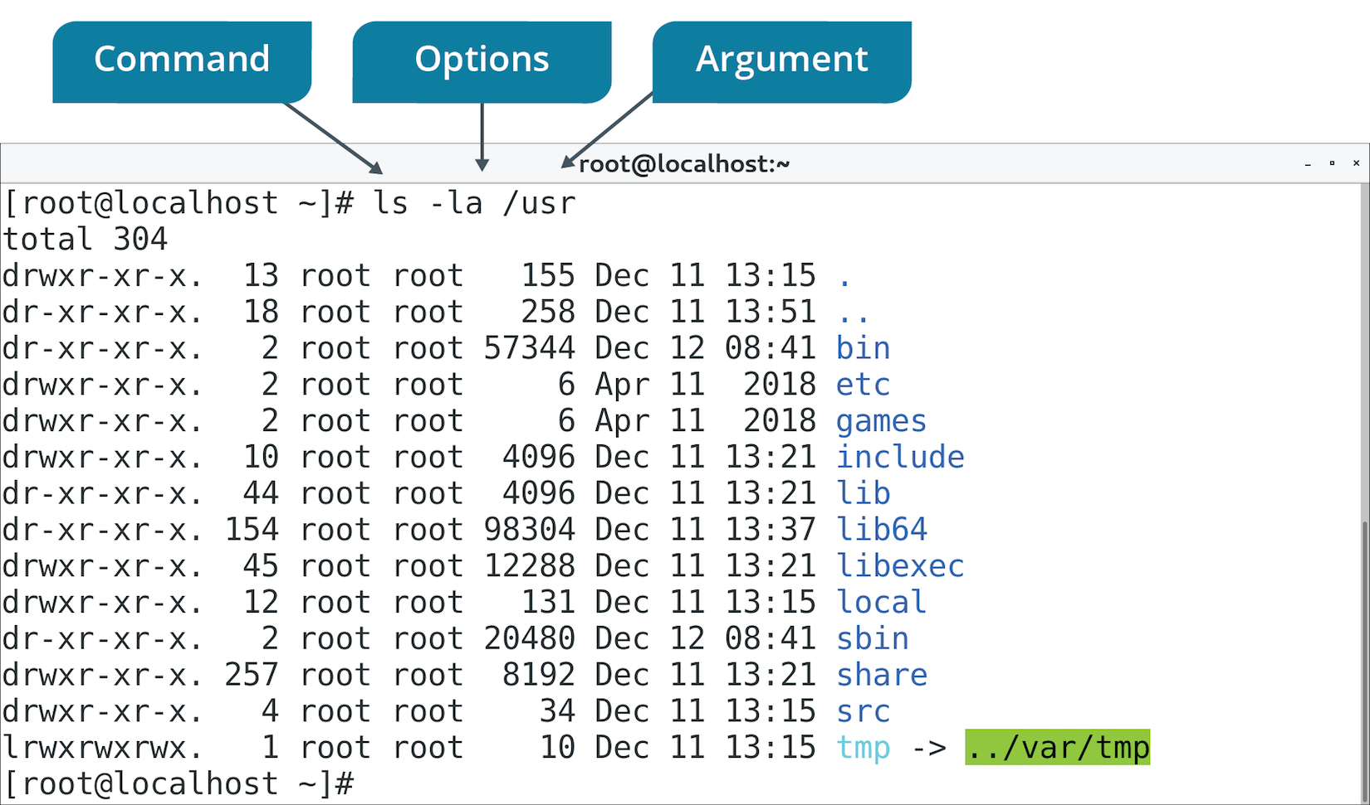
Bash Syntax (Slide 2 of 2)

Slide 24
Basic Bash Commands
Command | Description | Examples
echo | Repeats input back to user. | echo 'Good morning!'
ls | Lists contents of directory. | ls ls -a ls -l ls /var/log
pwd | Displays current working directory. | pwd
cd | Changes current working directory. | cd /var/log cd /etc
touch | Updates timestamp of file/creates file. | touch file1
cp | Copies a file or directory. | cp file1 file2
mkdir | Creates a new directory. | mkdir newdir

Slide 25
File Viewing Commands
System configs are in text files.
cat views contents of file.
Example: cat file1 shows contents of file1 on screen.
less breaks output into pages.
Example: less file1 shows contents even if they go past screen.
Press Page Up/Page Down to scroll.
Press q to exit.

Slide 26
File Editing Commands
vim
vim file1 to open file.
Press i to insert.
Press Esc to leave insert.
:wq to save/quit.
nano
nano file1 to open file.
Enter text directly.
Press Ctrl+O to save.
Press Ctrl+X to quit.
gedit
Select Applications→Accessories→Text Editor.
Enter text directly.
Use menu to save/quit.

Slide 27
Power Management Commands
shutdown -h now
Shuts down with no delay.
shutdown -h -t 90
Shuts down in 90 seconds.
shutdown -r now
Reboots with no delay.

Slide 28
Superuser Commands
Superuser has admin credentials.
Typically named root.
Avoid logging in as root.
Sometimes you'll need to assume superuser privileges.
su – switches/substitutes user credentials.
su - root switches/substitutes to root user.
System will prompt you for root password.

Slide 29
Shell History
Bash keeps a history of commands entered.
Use to repeat commands.
Examples:
history outputs list of recently entered commands.
Up/Down Arrow keys cycle through history. Press Enter to reissue command.

Slide 30
Tab Completion
A feature in which a command-line shell fills in the name of a command you've partially typed.
Supported by Bash.
Reduces errors and speeds up entering commands.
Examples:
Type his and press Tab to fill rest of history command.
Type cd /home/user1/Aug and press Tab to fill path to:
cd /home/user1/AugustProjects

Slide 31
Shell Tips and Tricks
Get in the habit of using tab completion.
Use history instead of re-writing long commands.
Read the command backward to troubleshoot issues.
Clear the screen with the clear command.

Slide 32
Discussing Shell Commands

Slide 33
Activity: Entering Shell Commands
CTO is considering switching servers to Linux.
He wants you to become familiar with using Linux.
You'll boot up a test machine and try it out.
You'll start by entering basic commands at the Bash shell.

Slide 34
Linux Documentation
Documentation is a necessity.
Helps users perform activities and resolve issues.
Any job role or experience level.
No official comprehensive source of Linux documentation.
Spread across multiple sources in multiple forms.
Example sources:
Manual pages
Built-in help commands
Online documentation projects
Usenet newsgroups
Internet mailing lists
Q&A websites
Forums/social media
Books/other print resources

Slide 35
Manual Pages (Slide 1 of 2)
The complete documentation for specific Linux commands.
Available on Linux systems by default.
Use the man command to display pages.
Include information such as:
Syntax
Description
Options
Example usage
Related commands
Most immediate source of help for commands.
Useful when you have no Internet access.
Can be difficult to parse for new users.

Slide 36
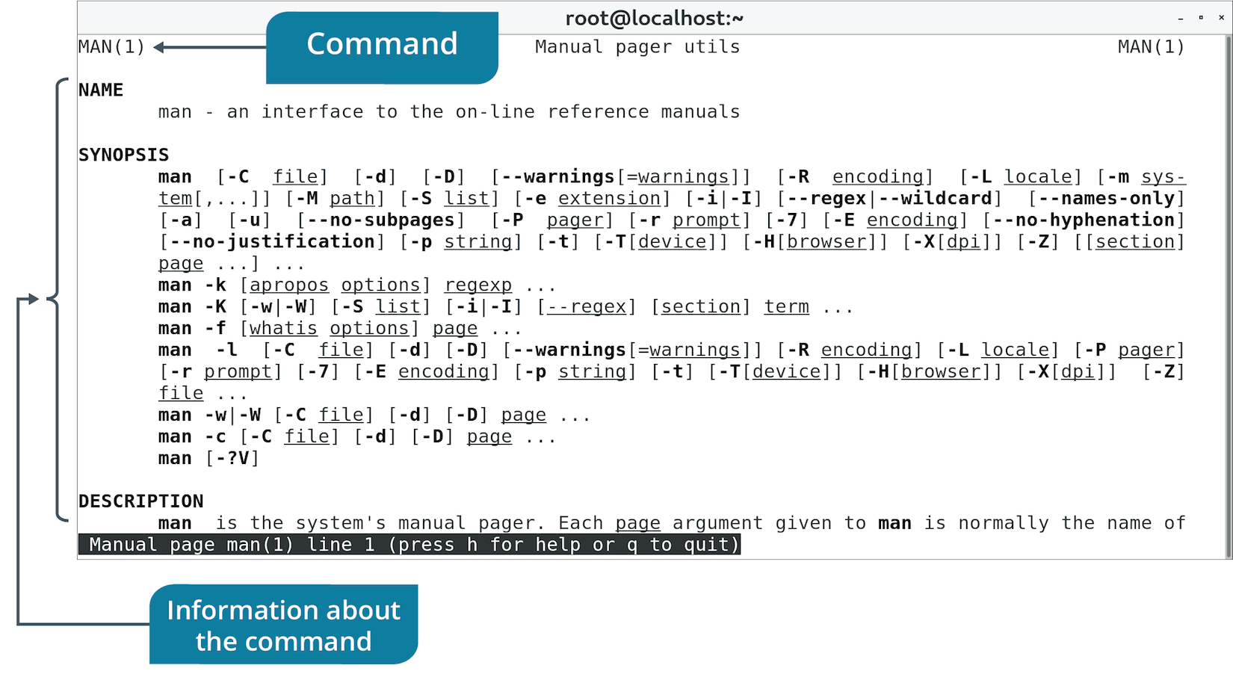
Manual Pages (Slide 2 of 2)

Slide 37
Other Built-In Help Options
Help Option | Description
apropos | Searches NAME section of man pages based on keyword. Helps you find the right command to use for a certain task. Syntax: apropos {keyword}
whatis | Displays brief description of given command. Helps you figure out what a command does. Syntax: whatis {command}
info | Displays info page of command. Similar to man pages, with some improvements. Not as widely adopted as man pages. Syntax: info {command}
--help | Displays quick summary of command usage and arguments. Syntax: <command> --help
/usr/share/doc/ | Directory of documentation for software packages. Includes author, licensing, installation, README, etc.

Slide 38
Online Documentation (Slide 1 of 2)
Online Source | Description
Official distro documentation | Some distros provide official documentation for that distro. Includes release notes, installation guide, etc.
LDP | All-volunteer project for comprehensive Linux documentation. Provides HOWTOs, Guides, FAQs, man pages, etc.
Linux man-pages project | Official man pages for Linux kernel/C library function interfaces available to user space programs.
GNU coreutils manual | Official source of documentation for GNU core utilities. coreutils is GNU software package compiled with Linux kernel.

Slide 39
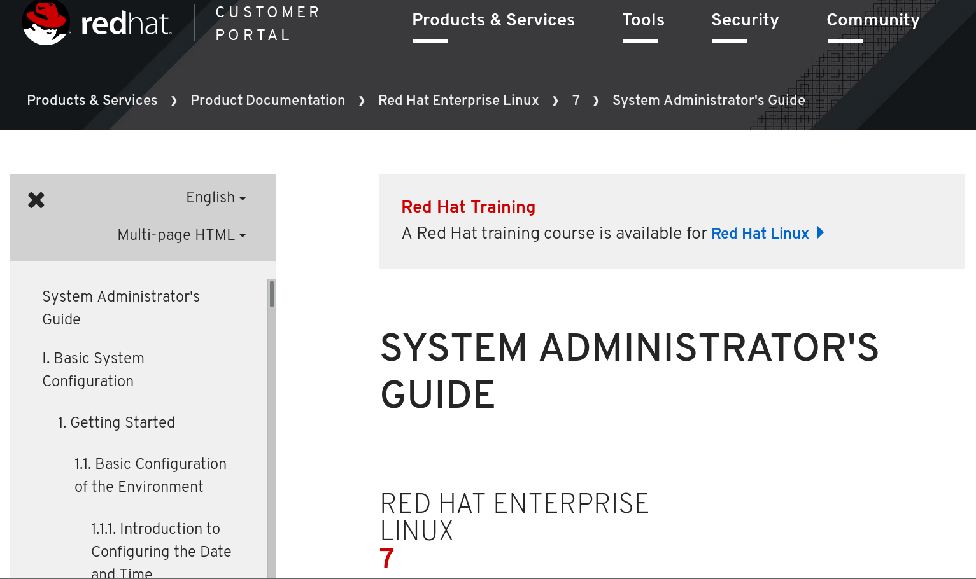
Online Documentation (Slide 2 of 2)

Slide 40
Interactive Help
Online Source | Description
Usenet newsgroups | Online discussion similar to bulletin board systems. Users post to group in threads. comp.os.linux.help, comp.os.linux.answers, comp.os.linux.admin
Mailing lists | Similar to newsgroups but threads are sent over email. Some distros have their own mailing lists. General mailing lists: https://lists.linuxfoundation.org/mailman/listinfo
Q&A websites | Users post questions and other users provide answers/comments. Posts are "liked" or "upvoted" by community. Example: https://unix.stackexchange.com/
Forums and social media | Threaded posts using web protocols. Some forums encourage questions and discussion on Linux topics. Example: https://www.linuxquestions.org/ Social media sites can provide forum-like discussion platforms. Example: https://www.reddit.com/r/linuxquestions/

Slide 41
Discussing Help in Linux

Slide 42
Activity: Accessing Help in Linux
Linux must have tools with certain capabilities.
Wants to be able to easily search the contents of text files.
Analyze log files, scripts, etc.
Look for specific patterns.
You need to find one or more tools that can do this.
You'll consult various help resources.

Slide 43
How is Linux used in your organization? Are there any existing systems that could benefit from switching to Linux?
What is your preferred method for getting help with Linux, and why?

